Slide 1
Extend PowerApps and Flow using Custom Connectors

Slide 2
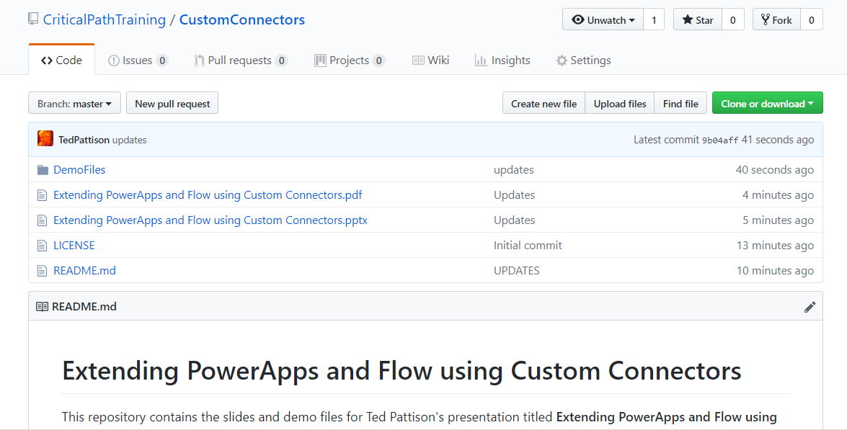
GitHub Repo
All slides and demo files available for download
https://github.com/CriticalPathTraining/CustomConnectors

Slide 3

Deep Dive into PowerApps and Flow
Two action-packed days of building PowerApps and Flows
Getting Started with PowerApps Studio
Designing PowerApps using Advanced Techniques
Building PowerApps for SharePoint Online
Introduction to Microsoft Flow
Designing Flows to Automate an Approval Process
Building PowerApps and Flows for Power BI
Working with the Common Data Service for Apps
Managing Application Lifecycle with PowerApps and Flow
More info
https://www.criticalpathtraining.com
info@criticalpathtraining.com

Slide 4
Agenda
Introduction to Custom Connectors
Creating a Simple Custom Connector
Authentication with Custom Connectors

Slide 5
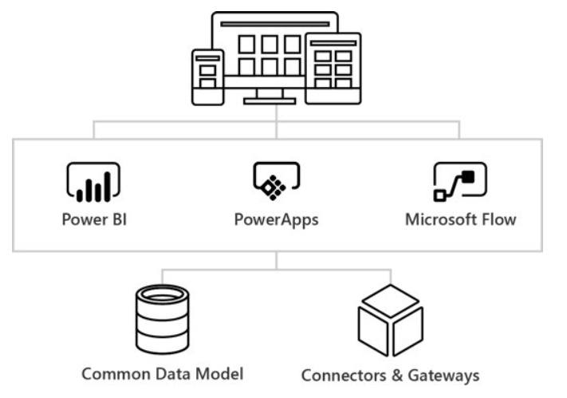
What is the Business Application Platform?
Notes:
PowerApps and Microsoft Flow are to important pieces of the Microsoft initiative known as the Business Application Platform. Together with Power BI, PowerApps and Flow make up the “Power Trio” of the Business Application Platform
The Business Application Platform has been specifically designed for business users and technical specialists who do not have the background of a software developer. The ultimate goal of the Business Application Platform is to allow business users and technical specialists within an organization to build custom applications and workflow solutions in a fraction of the time compared to the traditional lifecycle of a software development project. The Business Application Platform has also been designed with a mobile-first philosophy which makes it relatively easy and very effective to build applications that target mobile devices such as iPhones and Android phones.
The Business Application Platform consist of these services
PowerApps is a service for building and consuming web applications and mobile apps that connect to data
Microsoft Flow is a service for automating workflow across the growing number of apps and SaaS services
Power BI is a business analytics service which provides self-service BI and great interactive visualizations
The Common Data Service for Apps provides the native storage of business data in the PowerApps environment
Connectors and Gateways provide the Business Application Platform with access to external data

Slide 6
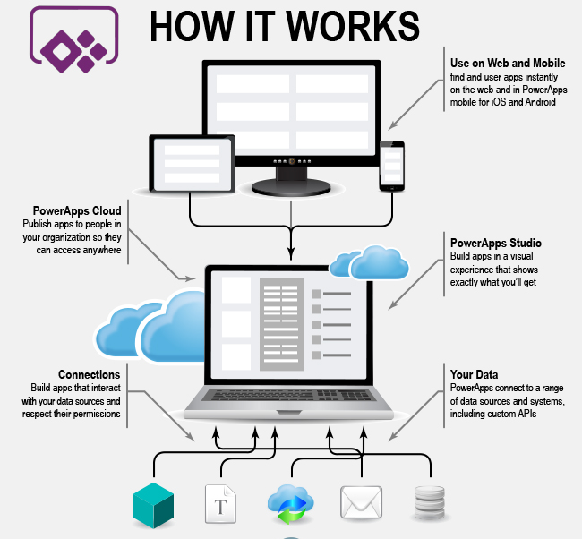
What is PowerApps?
Notes:
PowerApps is a service for building and consuming business apps. As an app builder, you can use any modern browser you like and you can work on a Windows PC or a Mac. It’s you’re choice. Once you build an app using PowerApps, it can be consumed by you and by other users in your organization through any modern browser as well. PowerApps can also be consumed on tablets and mobile devices by installing the PowerApps native app published by Microsoft.
One of the primary strengths of PowerApps is that is makes it quick and easy to build an app that reads and writes business data which is stored in terms of database records or SharePoint list items. PowerApps provides a “Start from Data” template for building a new app which automatically generates the screens for searching and updating database records.
PowerApps provides app builders the ability to access external data through the use of connectors. You can use a connector to create a connection to a datasource such as a SQL Server database or a SharePoint list. PowerApps provides over 100 other connectors out of the box for connecting to common data sources such as OneDrive, Excel, Azure Active Directory, Azure SQL Server and Dynamics 365.
One really valuable aspect of connectors and connections is that they are able to store and reuse security credentials when connecting to an external data source. When creating a connection, you are often promoted to provide security credential and grant permissions to the app using the connection. After that, PowerApps should be able to establish a secure connection to that datasource using the stored credentials.

Slide 7
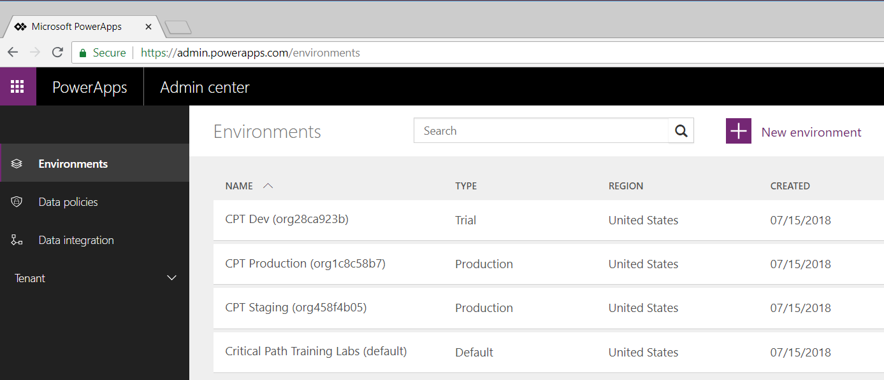
PowerApps Admin Center & Environments
PowerApps architecture based on environments
Environment provides context for creating apps and flows
Every tenant is automatically created with default environment
Organization can create multiple environments for dev & staging
PowerApps Plan 2 license required to manage environments
Notes:
The architecture for PowerApps and Flow is based on an important concept of “environments”. Any time you create a new app with PowerApps or a new flow, you are always doing so within the context of a specific environment.
You don’t have to think about environments when you start working with PowerApps. That’s because every new Office 365 tenant is automatically created with default environment. When you first begin to create apps and flows, you will be working within the default environment for the tenant that was created along with your new Office 365 trial account. During the first part of this training course, everything you do will be done in the default environment.
You can view and manage the environments for the current Office 365 tenant by navigating to the PowerApps Admin center at https://admin.powerapps.com. Note that you will not be able to view existing environments or create new environments until your Office 365 user account has been assigned a PowerApps Plan 2 license.
This training course provides a module on application lifecycle management (ALM) with PowerApps and Flow. At that point, the instructor will go into greater detail about creating and managing environments. As you will learn, an organization can benefit from creating multiple environments to assist with developing and staging the apps and flows they build. After building and testing apps and flows in a staging environment, an organization can design a strategy for packaging and deploying them into a production environment.

Slide 8
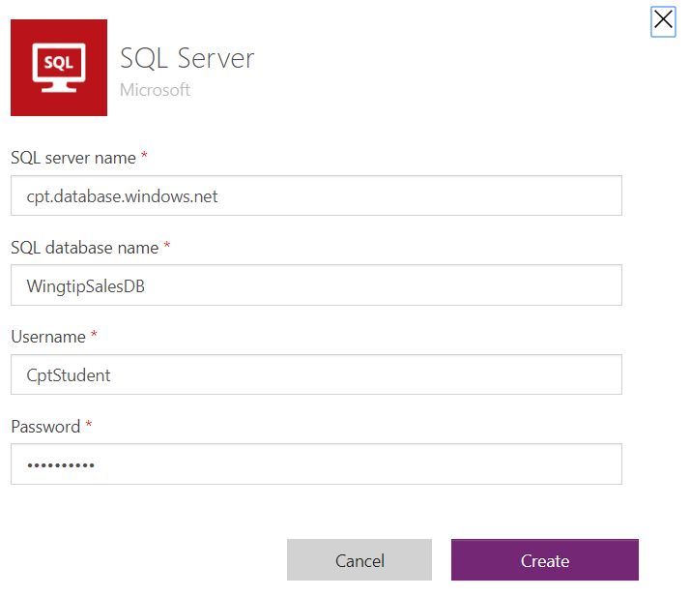
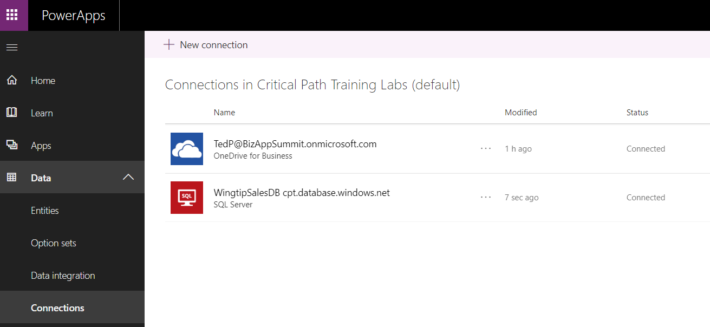
Understanding Connectors & Connections
What is a Connector?
API wrapper that PowerApps uses to interact with datasource
What is a Connection?
Configuration created to connect to a specific datasource
Each connection is created using a specific connector
Connection also caches login credentials and granted permissions
Connections can be shared across users
Notes:
One of the strengths of PowerApps is that it makes it relatively easy to build an app that connects to data. Keep in mind that the data you need to access may be stored in many different types of datasources. You bring that data into your app by creating connections. Each connection is created by a specific user and may be shared across users. If you navigate to the PowerApps home page, you can see your current set of connections by navigating to Data > Connections node in the left navigation menu as shown in the screenshot in the slide above.
To become proficient at building apps with PowerApps, you must learn the key concepts involved with connectors. A connector is a wrapper around an API that PowerApps uses to interact with a specific type of datasource. Each connection you create is based on a specific connector which knows how to communicate with the datasource to which you are connecting. PowerApps provides out-of-the-box connectors for many popular services and on-premises datasources including SQL Server, SharePoint, OneDrive for Business, Azure AD, Dynamics 365, Salesforce and Twitter.
There are two important aspects of connectors and connections that relate to security. When using a connection for the first time, the user is often prompted to provide security credentials such as a user name and password to establish a secure connection to the datasource. After the user supplies security credentials the first time, the connection is able to cache those credentials and reuse them to reestablish connections to that datasource in the future without any need for user interaction.
The second security-related aspect of connections has to do with users delegating permissions to an app. A connection often allows an app to read and write to a datasource on behalf of the current user. PowerApps prompts users with an interactive dialog which allows a user to grant permissions to a connection which is required in order to read and write to a datasource on a user’s behalf.

Slide 9
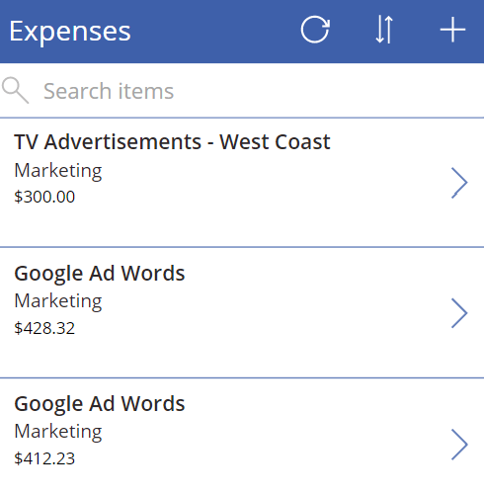
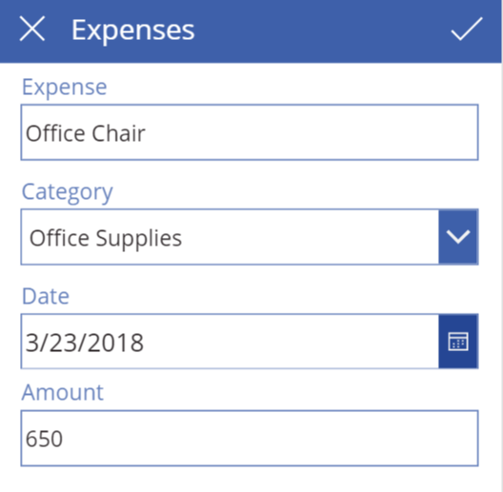
Data Binding with Galleries and Forms
Table binding
Gallery control
DataTable control
Single-record binding
Display form control
Edit form control
Notes:
Data binding is one of the key features in PowerApps that dramatically simplifies the process of building an app to access data. When you create a new app using the ‘Start from data’ template, PowerApps Studio will use data binding when it generates the connection, the screens and the controls for the app. This means you can use data binding without really understanding how it works. However, learning how data binding really works in PowerApps will help you become a better app builder.
Data binding in PowerApps is based tabular data which is laid out in terms of tables and records. Some controls support data binding to a table of records while other controls support binding to a single record at a time. The Gallery control and the DataTable control are examples of controls that can be bound to a table of records. For example, you can create a Gallery control to display a set of expenses.
Forms are a special type of control that support data binding with a single record of data at a time. You can use a Display Form control when you want to display a single record of data in a read-only fashion. You can use an Edit Form control when you want to build a screen that allows a user to add a new record or to edit an existing record.

Slide 10
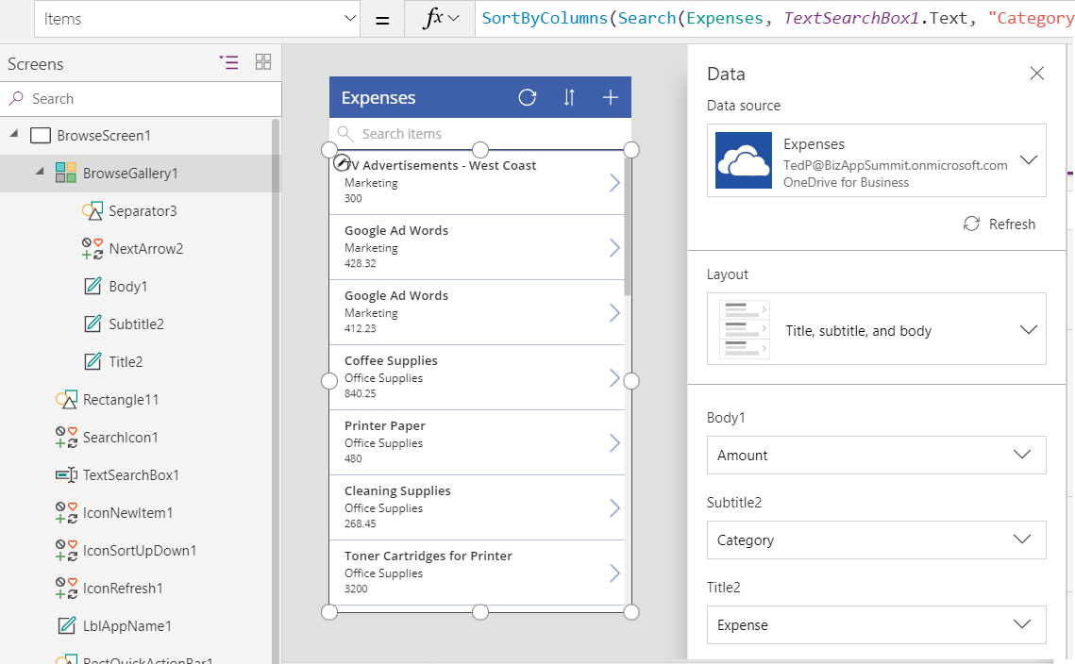
Working with the Data Pane
You use the Data pane to configure data binding
Select a data-bound control and then display Data pane
Data pane allows you to change layout for data binding
Once you select layout, you can then map fields below
Data-bound control
Data-bound connection
Data-binding layout
Field mappings
Notes:
In order to customize the way data binding works, you must learn to use the Data Pane in PowerApps Studio. You use the Data Pane when you need to configure or customize the data binding for a data bound control such as the Gallery control. In order to use the Data pane, you must first select the data-bound control in the left navigation and then you can open the Data pane by navigating to the View tab in the ribbon and clicking the Data sources button. When a Gallery control is selected, the Data pane shows the details of the data binding including the connection, the data binding layout and the field mappings. It’s easy to switch back and forth between different layouts and to update the field mappings to creating a better view of the underling data.
There is a common design pattern used in PowerApps where an app is created with three screens including (1) a browser screen, (2) a detail screen and (3) an edit screen. All three screens are used to data bind to the same underlying table. The browser screen contains a Gallery control with data binding to display many records at once. The detail screen uses a Display Form control to display the data for a single record in a read-only fashion. The edit screen contains an Edit Form control which allows users of the app to add new records and edit existing records.

Slide 11
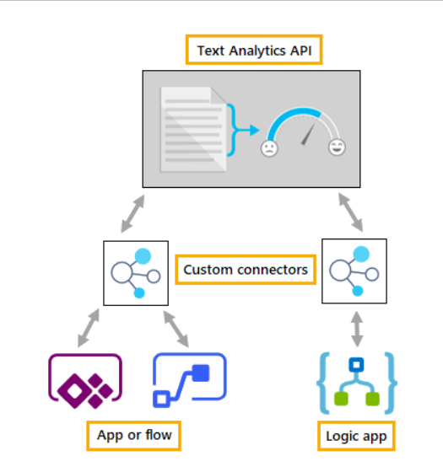
Standard Connectors vs Custom Connectors
PowerApps Supports two types of connectors
Standard connectors supplied out-of-box and vetted by Microsoft
Custom connectors created by organizations for their own use
Notes:
PowerApps supports both standard connectors and custom connectors. The difference is that Microsoft provides standard connectors out-of-the-box as part of the PowerApps platform. If you're connecting to a data source that PowerApps supports with a standard connector, you should use that connector. If you need to connect to a datasource for which Microsoft does not provided a standard connector, you can create a custom connector to integrate the data from that datasource.
Many connectors are designed to work with tabular datasources such as tables in Excel workbooks, tables in SQL Server and lists in SharePoint. With a tabular-based connector, data can be modeled as a table with rows and columns. PowerApps provides its functions for tabular datasources as Patch, Collect and Update which you can call to interact with data in an underlying table. You should also keep in mind that tabular datasources make it easy to use data binding with Gallery controls and Form controls.
PowerApps also supports function-based connectors to interact with datasources that do not fit within the tabular connector model. For example, there are connectors that connect to SaaS services such as Office 365, Twitter and Facebook. When working with function-based connectors, PowerApps is able to move data back and forth between an app and a datasource by executing web service calls against the external Saas service. You can still use these types of connectors to bind data to galleries and forms, but it usually requires a little more work. That’s because you must typically cache the data returned from a function-based connector into a variable or collection in order to bind the data to a gallery or a form.

Slide 12
Inspecting the Custom Connectors within a PowerApps Environment

Slide 13
Agenda
Introduction to Custom Connectors
Creating a Simple Custom Connector
Authentication with Custom Connectors

Slide 14
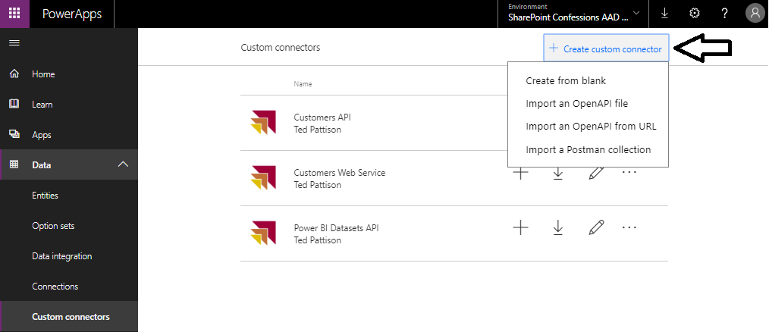
Creating a New Custom Connector

Slide 15
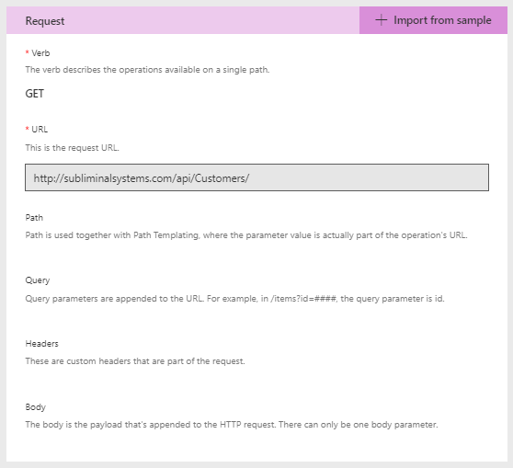
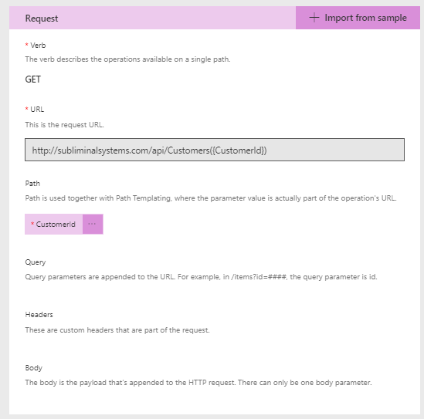
Defining Requests

Slide 16
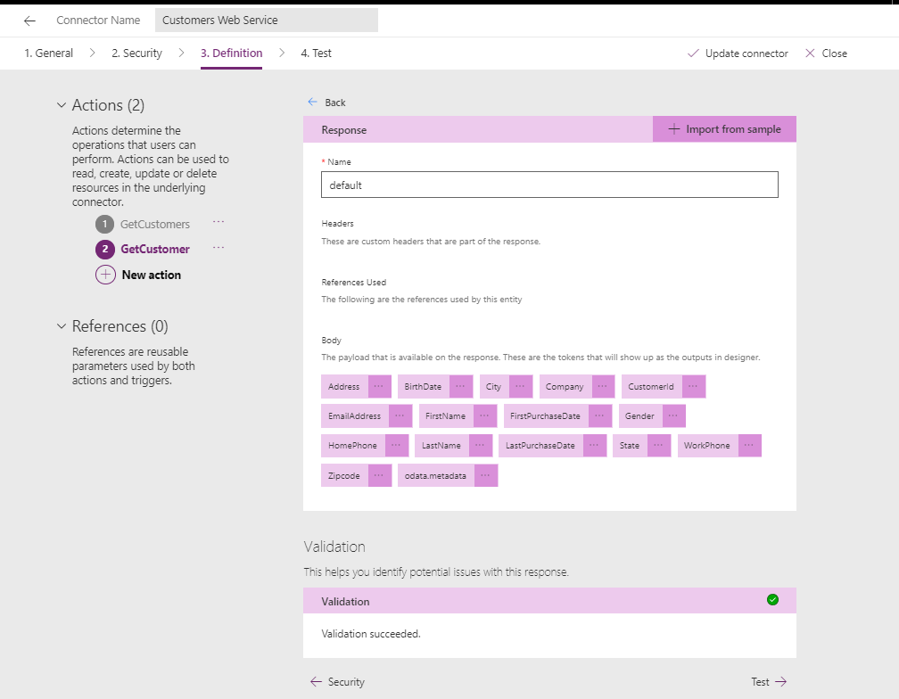
Defining the Response

Slide 17
Agenda
Introduction to Custom Connectors
Creating a Simple Custom Connector
Authentication with Custom Connectors

Slide 18
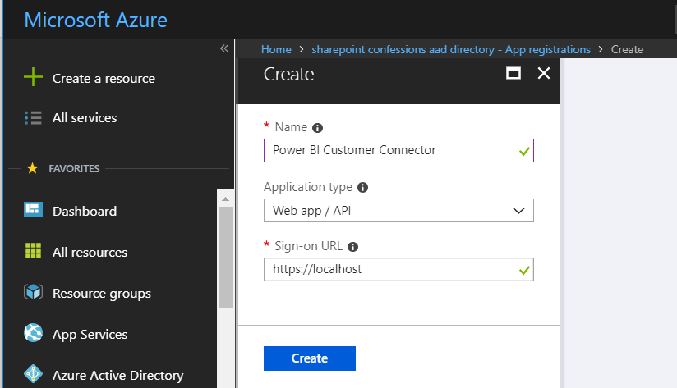
Creating an Azure AD Application

Slide 19
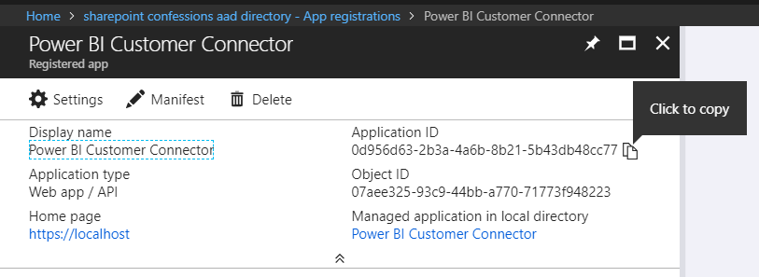
Application ID (aka Client ID)

Slide 20
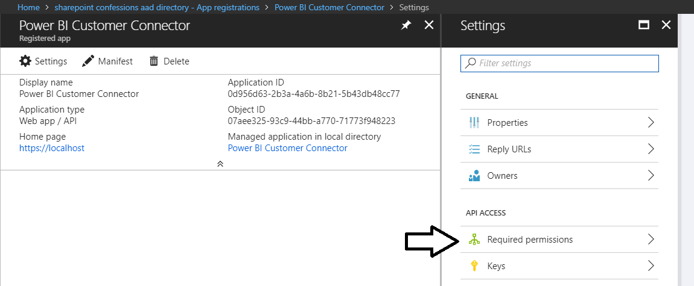
Configuring Permissions

Slide 21
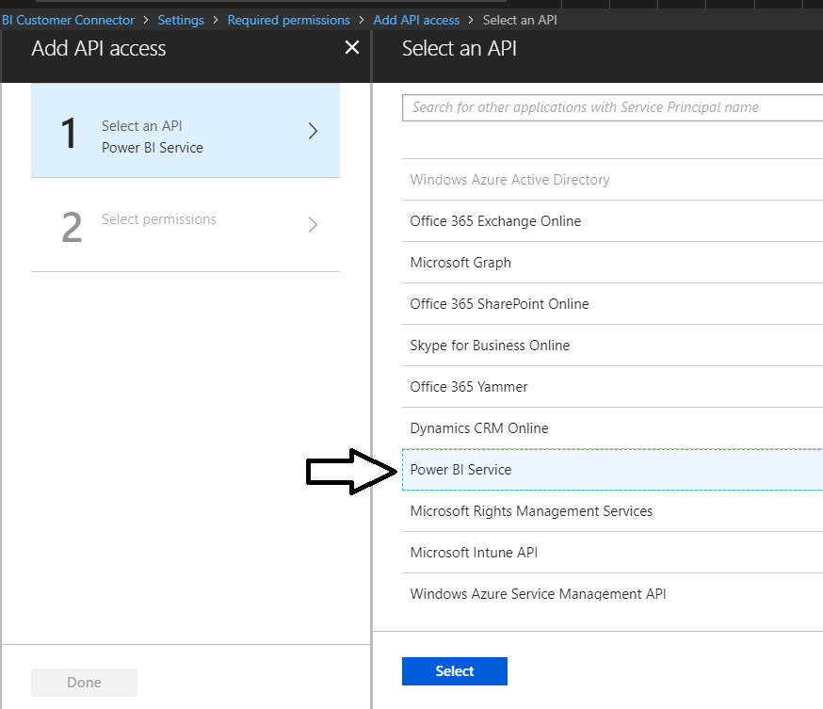
Select the Power BI Service for the API

Slide 22
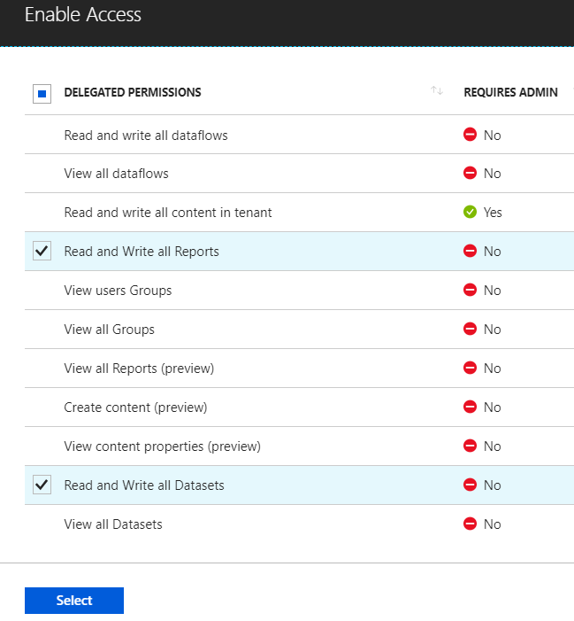
Select the Required Permissions

Slide 23
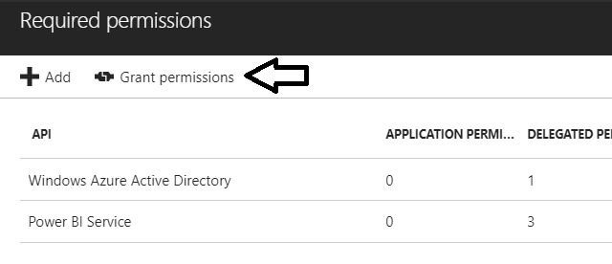
Granting Permissions in Azure AD Portal

Slide 24
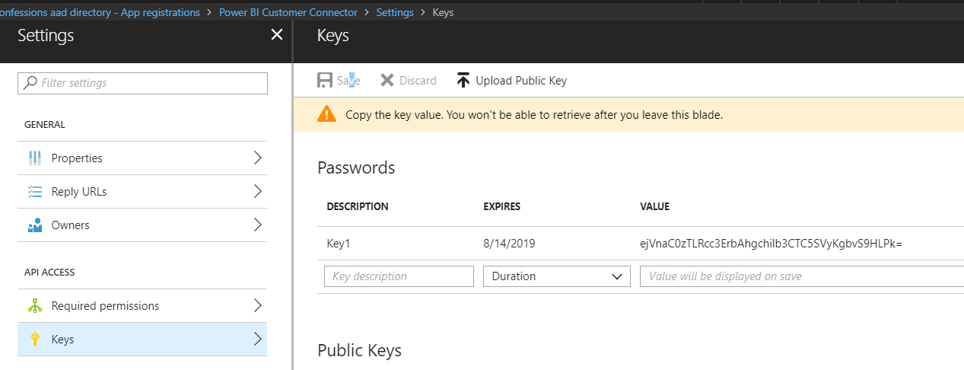
Generating a Key Secret

Slide 25
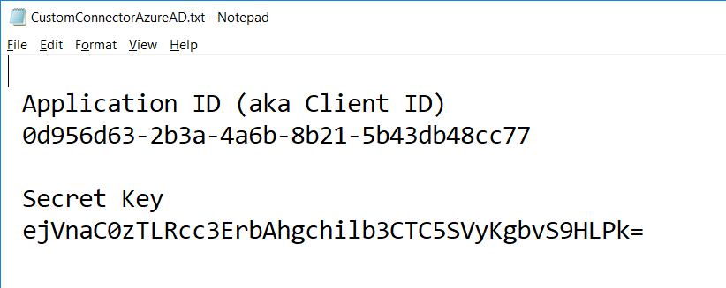
Data Required to Create Custom Connector

Slide 26
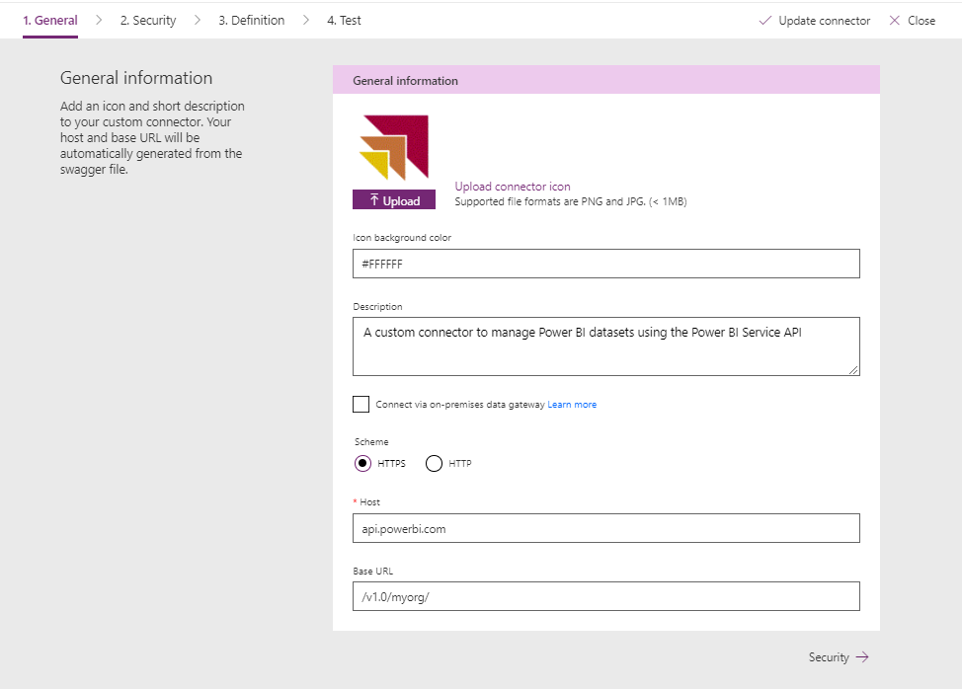
Creating the New Custom Connector

Slide 27
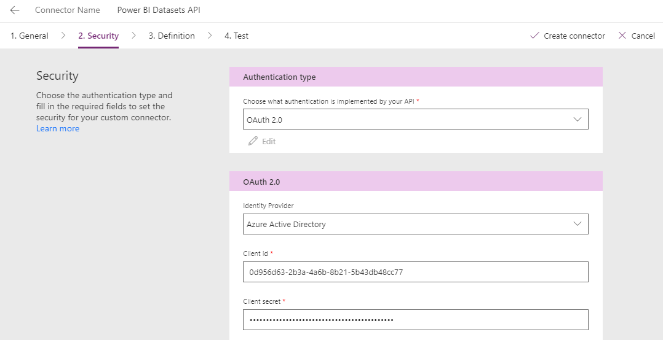
Configuring the Client Id and Client Secret

Slide 28
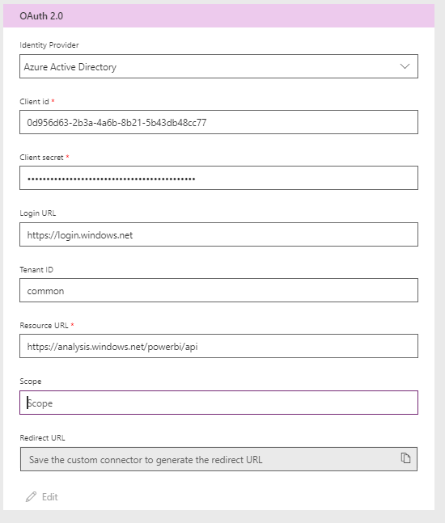
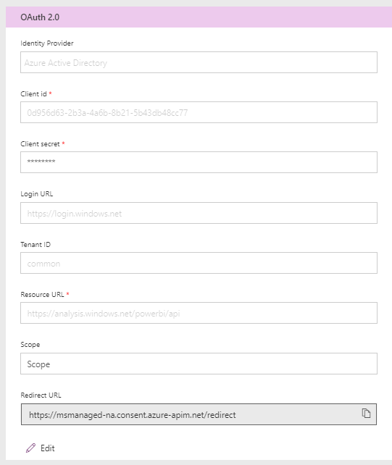
What About the Redirect URL?

Slide 29
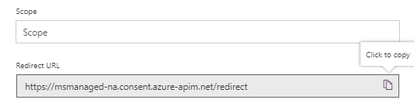
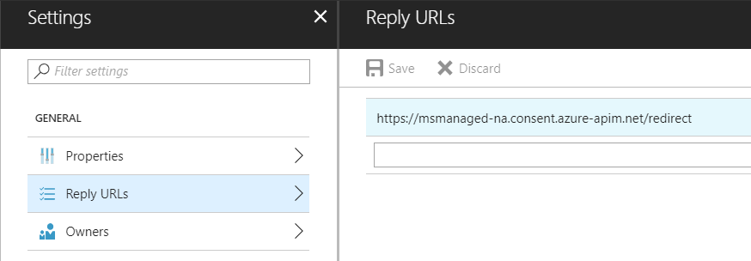
Adding the Redirect URL back in Azure AD

Slide 30
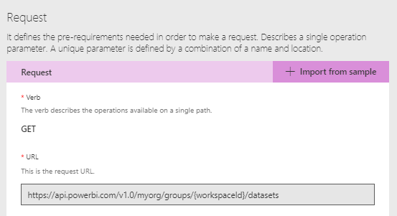
GetDatasets

Slide 31
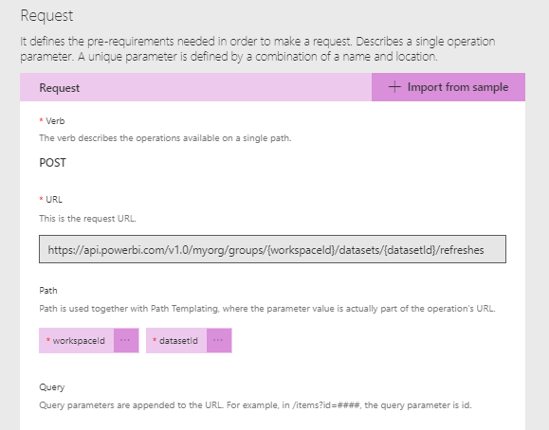
RefreshDataset

Slide 32
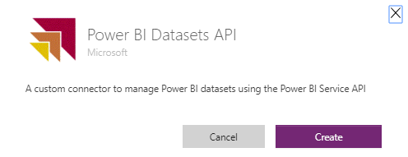
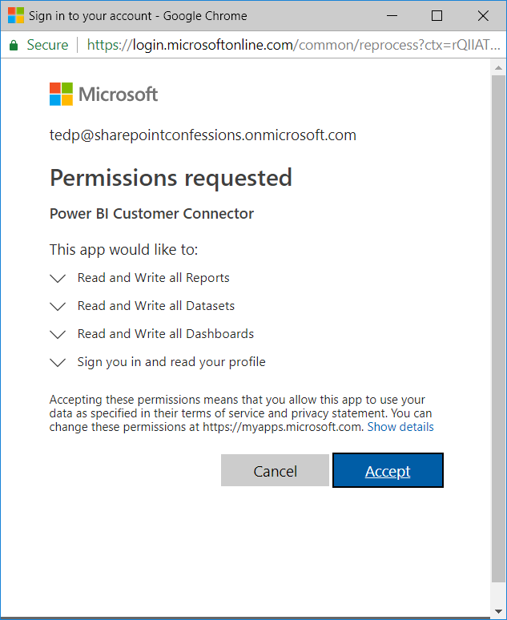
Creating a New Connection

Slide 33
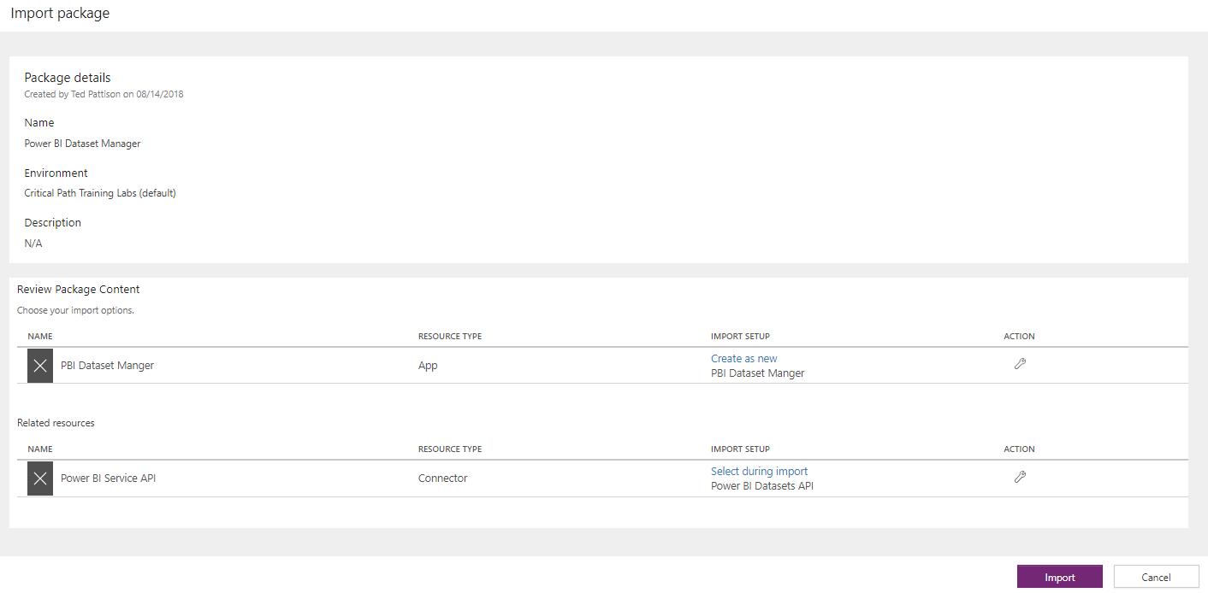
Importing Apps that use Custom Connections

Slide 34
Deep Dive into PowerApps and Flow
Two action-packed days of building PowerApps and Flows
Getting Started with PowerApps Studio
Designing PowerApps using Advanced Techniques
Building PowerApps for SharePoint Online
Introduction to Microsoft Flow
Designing Flows to Automate an Approval Process
Building PowerApps and Flows for Power BI
Working with the Common Data Service for Apps
Managing Application Lifecycle with PowerApps and Flow
More info
https://www.criticalpathtraining.com
info@criticalpathtraining.com

Slide 35
Summary
Introduction to Custom Connectors
Creating a Simple Custom Connector
Authentication with Custom Connectors

